Slide 1
PYTHON FUNCTIONS
Intro

Slide 2
WHAT IS FUNCTION ?
A function is a block of code which only runs when it is called.
You can pass data, known as parameters, into a function.
A function can return data as a result.

Slide 3
Defining and Calling a Function
Creating a Function
In Python a function is defined using the def keyword:
def my_function(): print("Hello from a function")
Calling a Function
To call a function, use the function name followed by parenthesis:
Example
def my_function(): print("Hello from a function") my_function()

Slide 4
Python Functions
There are two kinds of functions in Python.
Built-in functions that are provided as part of Python –
raw_input(), type(), float(), int() ...
Functions that we define ourselves and then use
We treat the of the built-in function names as "new" reserved words (i.e. we avoid them as variable names)

Slide 5
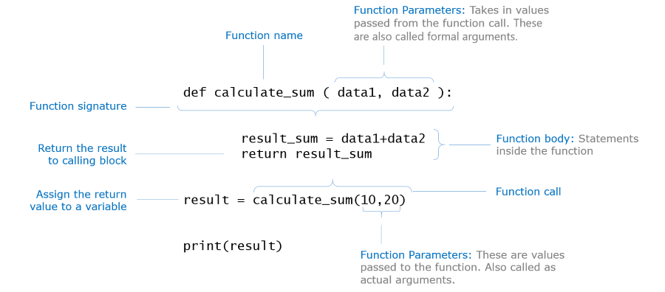

Slide 6
HOW FUNCTION DEFINITION WORKS
x = 5
print 'Hello'
def print_lyrics():
print "I'm a lumberjack, and I'm okay.”
print 'I sleep all night and I work all day.'
print 'Yo'
print_lyrics()
x = x + 2
print x
Hello
Yo
I'm a lumberjack, and I'm okay.I sleep all night and I work all day.
7

Slide 7
ARGUMENTS
Information can be passed into functions as arguments.
Arguments are specified after the function name, inside the parentheses. You can add as many arguments as you want, just separate them with a comma.
The following example has a function with one argument (fname). When the function is called, we pass along a first name, which is used inside the function to print the full name:
EG:
def my_function(fname): print(fname + " Refsnes") my_function("Emil") my_function("Tobias") my_function("Linus")

Slide 8
Parameters or Arguments?
The terms parameter and argument can be used for the same thing: information that are passed into a function.
From a function's perspective:
A parameter is the variable listed inside the parentheses in the function definition.
An argument is the value that is sent to the function when it is called.
def my_function(fname): print(fname + " Refsnes") my_function("Emil") my_function("Tobias") my_function("Linus")

Slide 9
Number of Arguments
By default, a function must be called with the correct number of arguments.
Meaning that if your function expects 2 arguments,
you have to call the function with 2 arguments,
not more, and not less.

Slide 10
Arbitrary Arguments, *args
If you do not know how many arguments that will be passed into your function, add a * before the parameter name in the function definition.
This way the function will receive a tuple of arguments, and can access the items accordingly:
def my_function(*kids): print("The youngest child is " + kids[2]) my_function("Emil", "Tobias", "Linus")

Slide 11
Keyword Arguments
You can also send arguments with the key = value syntax.
This way the order of the arguments does not matter.
def my_function(child3, child2, child1): print("The youngest child is " + child3) my_function(child1 = "Emil", child2 = "Tobias", child3 = "Linus")

Slide 12
Arbitrary Keyword Arguments, **kwargs
If you do not know how many keyword arguments that will be passed into your function, add two asterisk: ** before the parameter name in the function definition.
This way the function will receive a dictionary of arguments, and can access the items accordingly:
def my_function(**kid): print("His last name is " + kid["lname"]) my_function(fname = "Tobias", lname = "Refsnes")

Slide 13
Default Parameter Value
The following example shows how to use a default parameter value.
If we call the function without argument, it uses the default value:
def my_function(country = "Norway"): print("I am from " + country) my_function("Sweden") my_function("India") my_function() my_function("Brazil")

Slide 14
Passing a List as an Argument
You can send any data types of argument to a function (string, number, list, dictionary etc.), and it will be treated as the same data type inside the function.
E.g. if you send a List as an argument, it will still be a List when it reaches the function:
def my_function(food): for x in food: print(x) fruits = ["apple", "banana", "cherry"] my_function(fruits)

Slide 15
Return Values
To let a function return a value, use the return function
def my_function(x): return 5 * x print(my_function(3)) print(my_function(5)) print(my_function(9))

Slide 16
The pass Statement
Function definitions cannot be empty, but if you for some reason to create Function definition with no content, put in the pass statement to avoid getting an error.
def myfunction(): pass

Slide 17
Recursion
Python also accepts function recursion, which means a defined function can call itself.
Recursion is a common mathematical and programming concept. It means that a function calls itself. This has the benefit of meaning that you can loop through data to reach a result.
The developer should be very careful with recursion as it can be quite easy to slip into writing a function which never terminates, or one that uses excess amounts of memory or processor power. However, when written correctly recursion can be a very efficient and mathematically-elegant approach to programming.

Slide 18
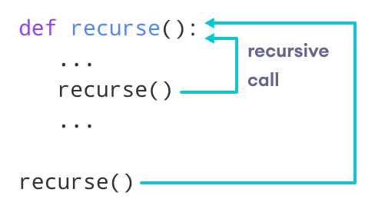

Slide 19
def factorial(x):
if x == 1:
return 1
else:
return (x * factorial(x-1))
num = 3
print("The factorial of", num, "is", factorial(num))

Slide 20
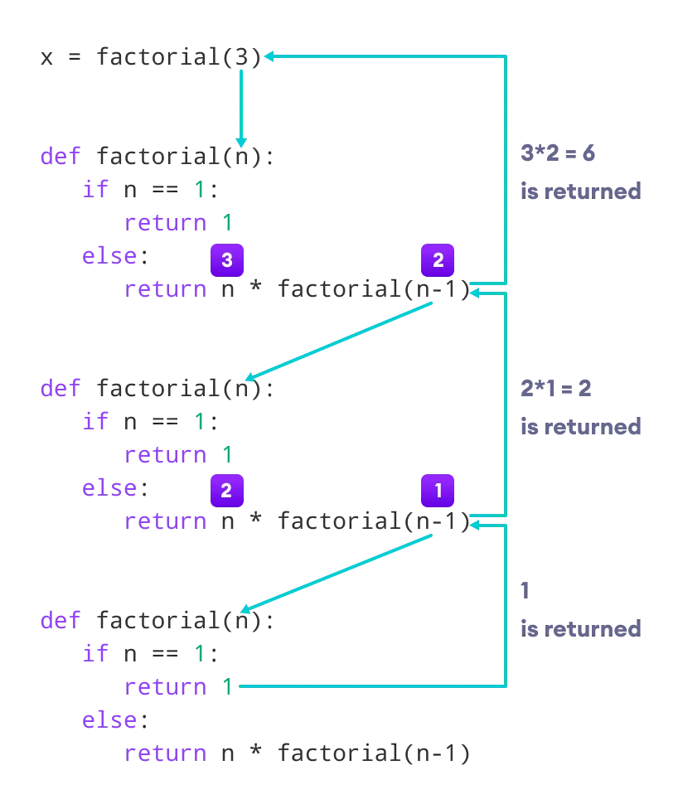

Slide 21
What are lambda functions in Python?
In Python, an anonymous function is a function that is defined without a name.
While normal functions are defined using the def keyword in Python,
anonymous functions are defined using the lambda keyword.
Hence, anonymous functions are also called lambda functions.
A lambda function is a small anonymous function.
A lambda function can take any number of arguments, but can only have one expression.

Slide 22
LAMBDA FUNCTION:
SYNTAX:
lambda arguments : expression
The expression is executed and the result is returned
Add 10 to argument a, and return the result
x = lambda a : a + 10
print(x(5))
In the above program, lambda a : a + 10 is a lambda expression,
a is an argument a+10 and is the expression that gets evaluated and returned.

Slide 23
This function has no name.
It returns a function object which is assigned to the identifier X .
We can now call it as a normal function.
The statement
x = lambda a : a + 10
Is same as
def x(a):
return a+10

Slide 24
Multiply argument a with argument b : x = lambda a, b : a * b print(x(5, 6)) sum of arguments a, b and c and return result: this is challenge for you students!!

Slide 25
Why use Lambda Functions ?
We use lambda functions when we require a nameless function for a short period of time.
Say you have a function definition that takes one argument, and that argument will be multiplied with an unknown number:
def myfunc(n): return lambda a : a * n mydoubler = myfunc(2) # 2 will go as function call in n print(mydoubler(11)) # 11 will go to ‘a’ in lambda

Slide 26
def myfunc(n): return lambda a : a * n mydoubler = myfunc(2) mytripler = myfunc(3) print(mydoubler(11)) print(mytripler(11))

Slide 27
use map to apply a function to each element of an iterable
for example if you have a list containing radius of dozens of circles and we need to find the corresponding areas we can achieve this by using the map function
use filter to filter out values of an interval if they don't match the specified condition
for example we can use filter to remove negative numbers from a list of numbers

